Slide 1
Kernel and Kernel Architectures

Slide 2
What is a Kernel
Simplest definition is: it is nothings just more than a program
Core part of operating system
This single program is one of the first things loaded when your operating system starts up.
It handles allocating memory, converting software functions to instructions for your computer’s CPU, and dealing with input and output from hardware devices.
Functions of kernel: Process management, Memory management, device management, Access to computer resources etc.

Slide 3
Kernel and OS, are they same?
There is a difference between kernel and OS.
Kernel as described above is the heart of OS which manages the core features of an OS while if some useful applications and utilities are added over the kernel, then the complete package becomes an OS.

Slide 4
User Space and Kernel Space
The RAM can be divided into two parts.
  kernel space and user space.
The kernel runs in the kernel space, which no other programs can access.
User programs have to run in user space.
User space is a form of sand-boxing, where user programs can only access to memory that allocated to them so that they can't mess up other programs and the kernel.

Slide 5
Types of Kernel Architectures
Monolithic
  Earlier in this type of kernel architecture, all the basic system services like a process and memory management, interrupt handling etc were packaged into a single module in kernel space.
  In a modern day approach to monolithic architecture, the kernel consists of different modules which can be dynamically loaded and unloaded. This modular approach allows easy extension of OS's capabilities.
Examples: Microsoft Windows, Linux, Solaris

Slide 6
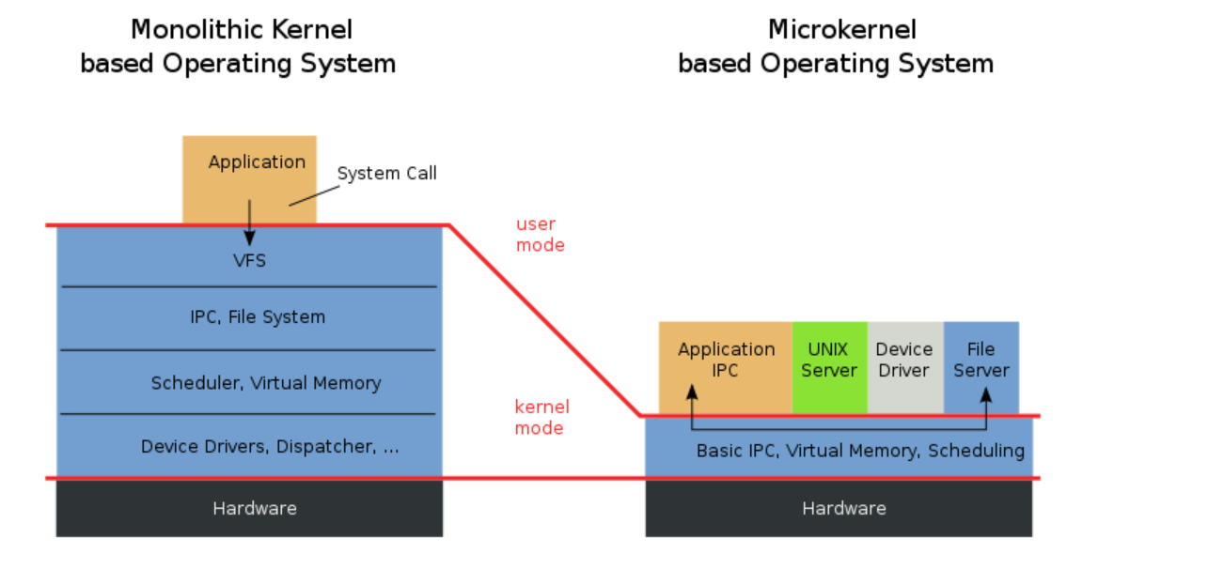

Slide 7
Types of Kernel Architectures
Microkernels
  This architecture allows some basic services like device driver management, protocol stack, file system etc to run in user space.
  This reduces the kernel code size and also increases the security and stability of OS as we have the bare minimum code running in kernel.
Examples: MacOS, Integrity, QNX

Slide 8
Types of Kernel Architectures
Exokernels
  Exokernel is an Operating System kernel that is developed by the MIT parallel and the Distributed Operating Systems group.
  the idea is not to implement all the abstractions.
  idea is to impose as few abstractions as possible and by doing so the abstraction should be used only when needed.

Slide 9
Two modes for a processor to work
User Mode
Kernel Mode

